Slide 1
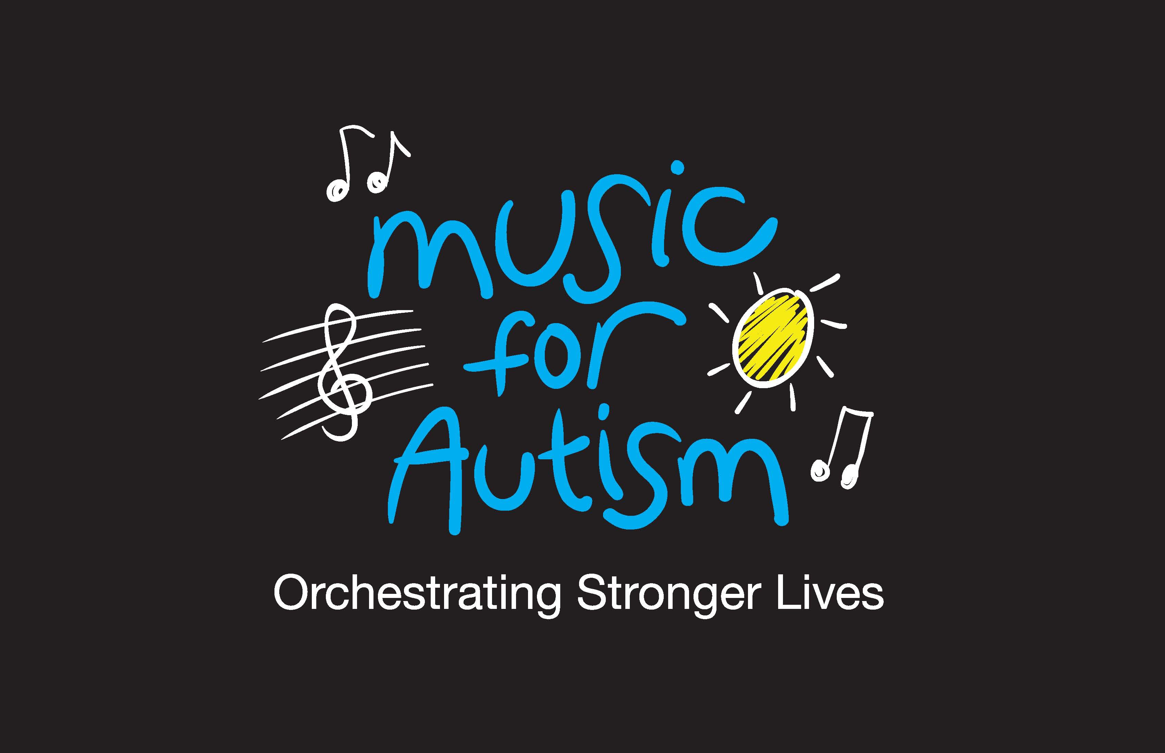

Unlocking the Potential of Music for Children with Autism: From Neuroscience to Quality of Life
The Help Group Summit 2014
October 18, 2014
Robert E. Accordino, MD, MSc
Fellow, Massachusetts General Hospital & McLean Hospital
Harvard Medical School
US Founder, Music for Autism
Robert@MusicForAutism.org

Slide 2

Acknowledgements
All participants in the studies and their families and schools
At Oxford University:
Professor Dorothy Bishop and the O.S.C.C.I. (Oxford Studies of Children’s Communicative Impairments) Team, Dr. Kate Nation, Dr. Liz Pellicano
At Princeton University:
Professor Ronald Comer, Professor Wendy Heller
At Mount Sinai School of Medicine:
Dr. Angela Diaz
The Members of the Board and Junior Board of Directors of Music for Autism, including The Help Group’s Dr. Barbara Firestone
All Music for Autism Volunteers and Musicians
The Australian-American Fulbright Commission, The Rotary Ambassadorial Scholarships Program, Overseas Research Studentships, and The Bailey Thomas Charitable Trust

Slide 3
Outline of Presentation
Music and language processing in autism
Music therapy for those with autism
The socioeconomics of autism
Advocacy through Music for Autism

Slide 4
Explorations of Music and Language Processing in Individuals with Autism

Slide 5
Musical Abilities of Those with Autism
First described by Leo Kanner (1943)
Rimland’s Infantile Autism (1964)
Repetition Study (Applebaum et al., 1979)
Recent empirical investigations on pitch, interval, and contour processing

Slide 6
Music and Language Processing
Left hemisphere-language?
Right hemisphere-music?
Music and language
  Universal
  Analogous components processed similarly (Patel, 2003)

Slide 7
“I can better tell people how I am by playing a song in my mind.”
Harold Stone, a 52-year-old with high functioning autism

Slide 8
Music and Language Processing
Psychological Evidence
  Music and language abilities correlate (Simmons & Baltaxe, 1975)
    No longer valid
Neurological Evidence with Event Related Potentials (ERPs)
  Music and language abilities divergent (Ceponiene et al., 2003)

Slide 9
Event-Related Potentials (ERPs)
Electrodes
Mismatch Negativity (MMN)
Standard
Deviant
8
Amplitude (μV)
0
-8
-100
200
350
Latency (ms)

Slide 10
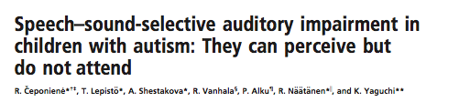
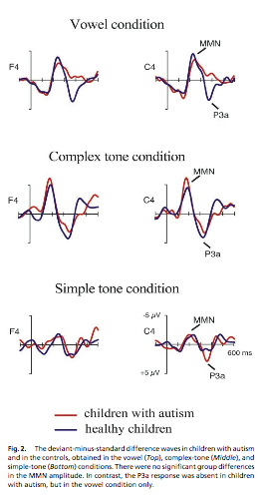

Slide 11
Music and Language Processing
Children with autism show similar musical processing in the context of poorer language
This musical processing is heterogeneous
  May only be present in a subgroup

Slide 12
Music Therapy for Those With Autism

Slide 13
Music Therapy Defined
“Music therapy may be defined as a planned, goal-directed process of interaction and intervention, based on assessment and evaluation of individual clients’ specific needs, strengths, weaknesses, in which music or music-based experiences (e.g., singing, playing musical instruments, moving or listening to music, creating or discussing songs and music) are specifically prescribed to be used by specially trained personnel (i.e., music therapists or those they train and supervise) to influence positive changes in an individual’s condition, skills, thoughts, feelings and behaviors.”
Music Therapy, An Introduction by Jacqueline Peters

Slide 14
Music Therapy
Has been used to treat disorders ranging from AIDS to Alzheimer’s, depression and cancer and became a formal area of study in the 1950s
Therapy carried out by a therapist in a controlled and programmed manner, often in collaboration with doctors or other therapists
The client need not have musical ability to benefit from therapy, and any increase in musical knowledge is a byproduct of therapy and is not a goal

Slide 15
Types of Music Therapy
Receptive
Compositional
Improvisational
Recreative
Activity
Music imaging

Slide 16
Music Therapy with Individuals with Autism:
Widely Recommended . . .
German postal survey (Evers, 1992):
  56% of child psychiatrists
  14.5% of pediatricians
recommended music therapy for individuals with autism
  25.1% of pediatricians
thought music therapy for individuals with autism might be useful

Slide 17
Music Therapy with Individuals with Autism:
Under Researched…
Mostly case studies, need for greater systematic research (Accordino et al., 2007)
Meta-Analysis of music therapy with children and adolescents with psychopathology (Gold et al., 2004)
  With no studies on those with autism, medium to large effect size of music therapy on those with childhood psychopathology, d = .61 (SE = .14), p < .001

Slide 18
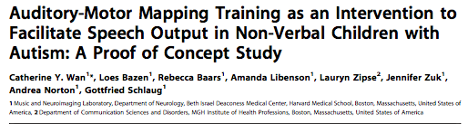
September, 2011 within subjects study
6 nonverbal participants with autism aged 5-9
At baseline, no intelligible words
AAMT: introduction of words through simultaneous intoning them along with drum tapping at the same pitch
AAMT 5x weekly for 8-week period (total of 40 sessions)
All children with significant improvements in their ability to articulate words and phrases with sustained improvements at 4 and 8 weeks post treatment

Slide 19
The Socioeconomics of Autism

Slide 20
The Socioeconomic Picture of Autism
In 1960s, found higher rates of autism in higher socioeconomic areas
In 1980s, researchers argued that these findings may be an artefact of the ability of those from lower socioeconomic areas to get an ASD diagnosis and services for the disorder (where study participants were recruited)

Slide 21
The Socioeconomic Picture of Autism
Larsson et al. (2005) ran a population-based, case-control study in Denmark
  Has a uniformly organized and comprehensive health care system
  Showed that socioeconomic status (maternal education and parental wealth) did not associate with an autism diagnosis

Slide 22
Autism does NOT discriminate…
BUT our giving of autism diagnoses and services for those with autism do.

Slide 23
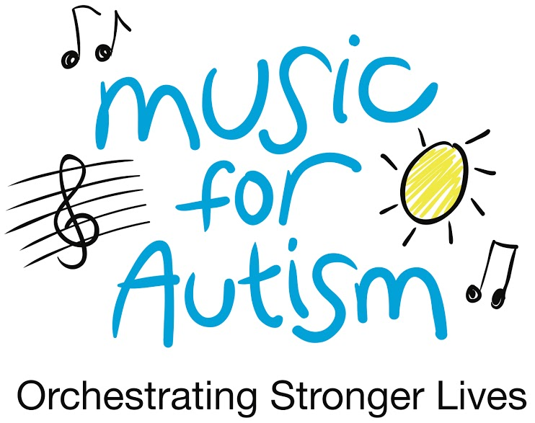
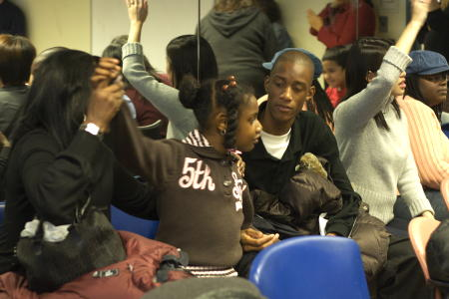
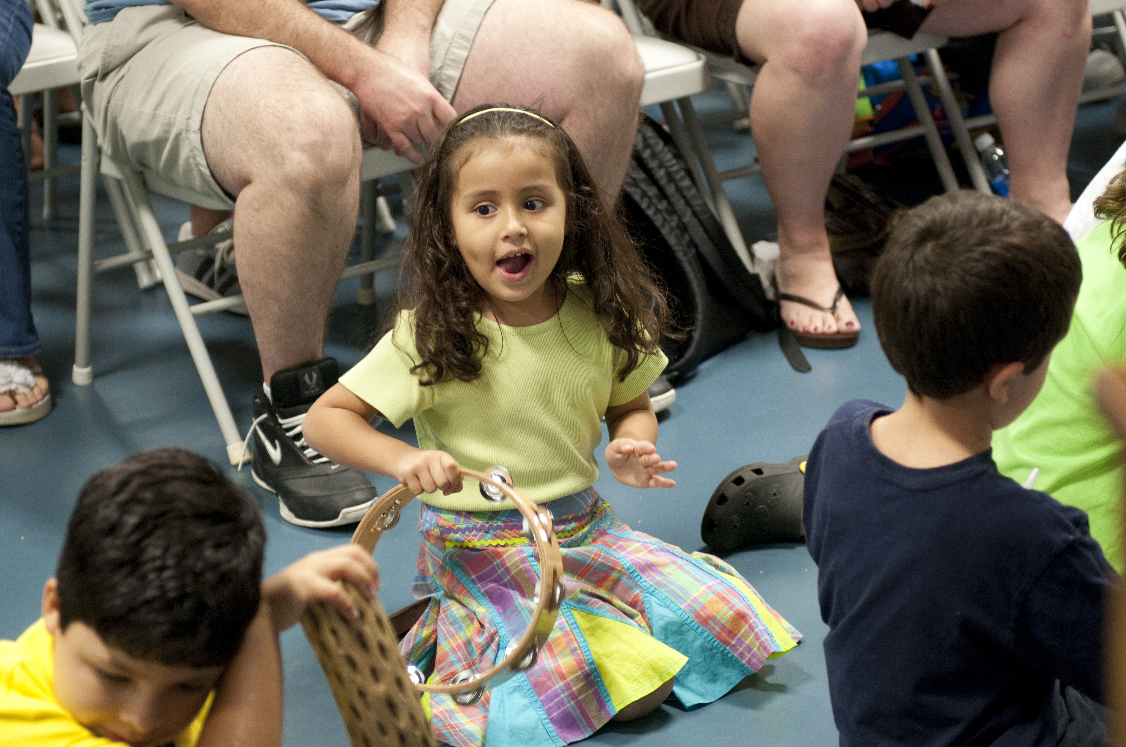

Slide 24
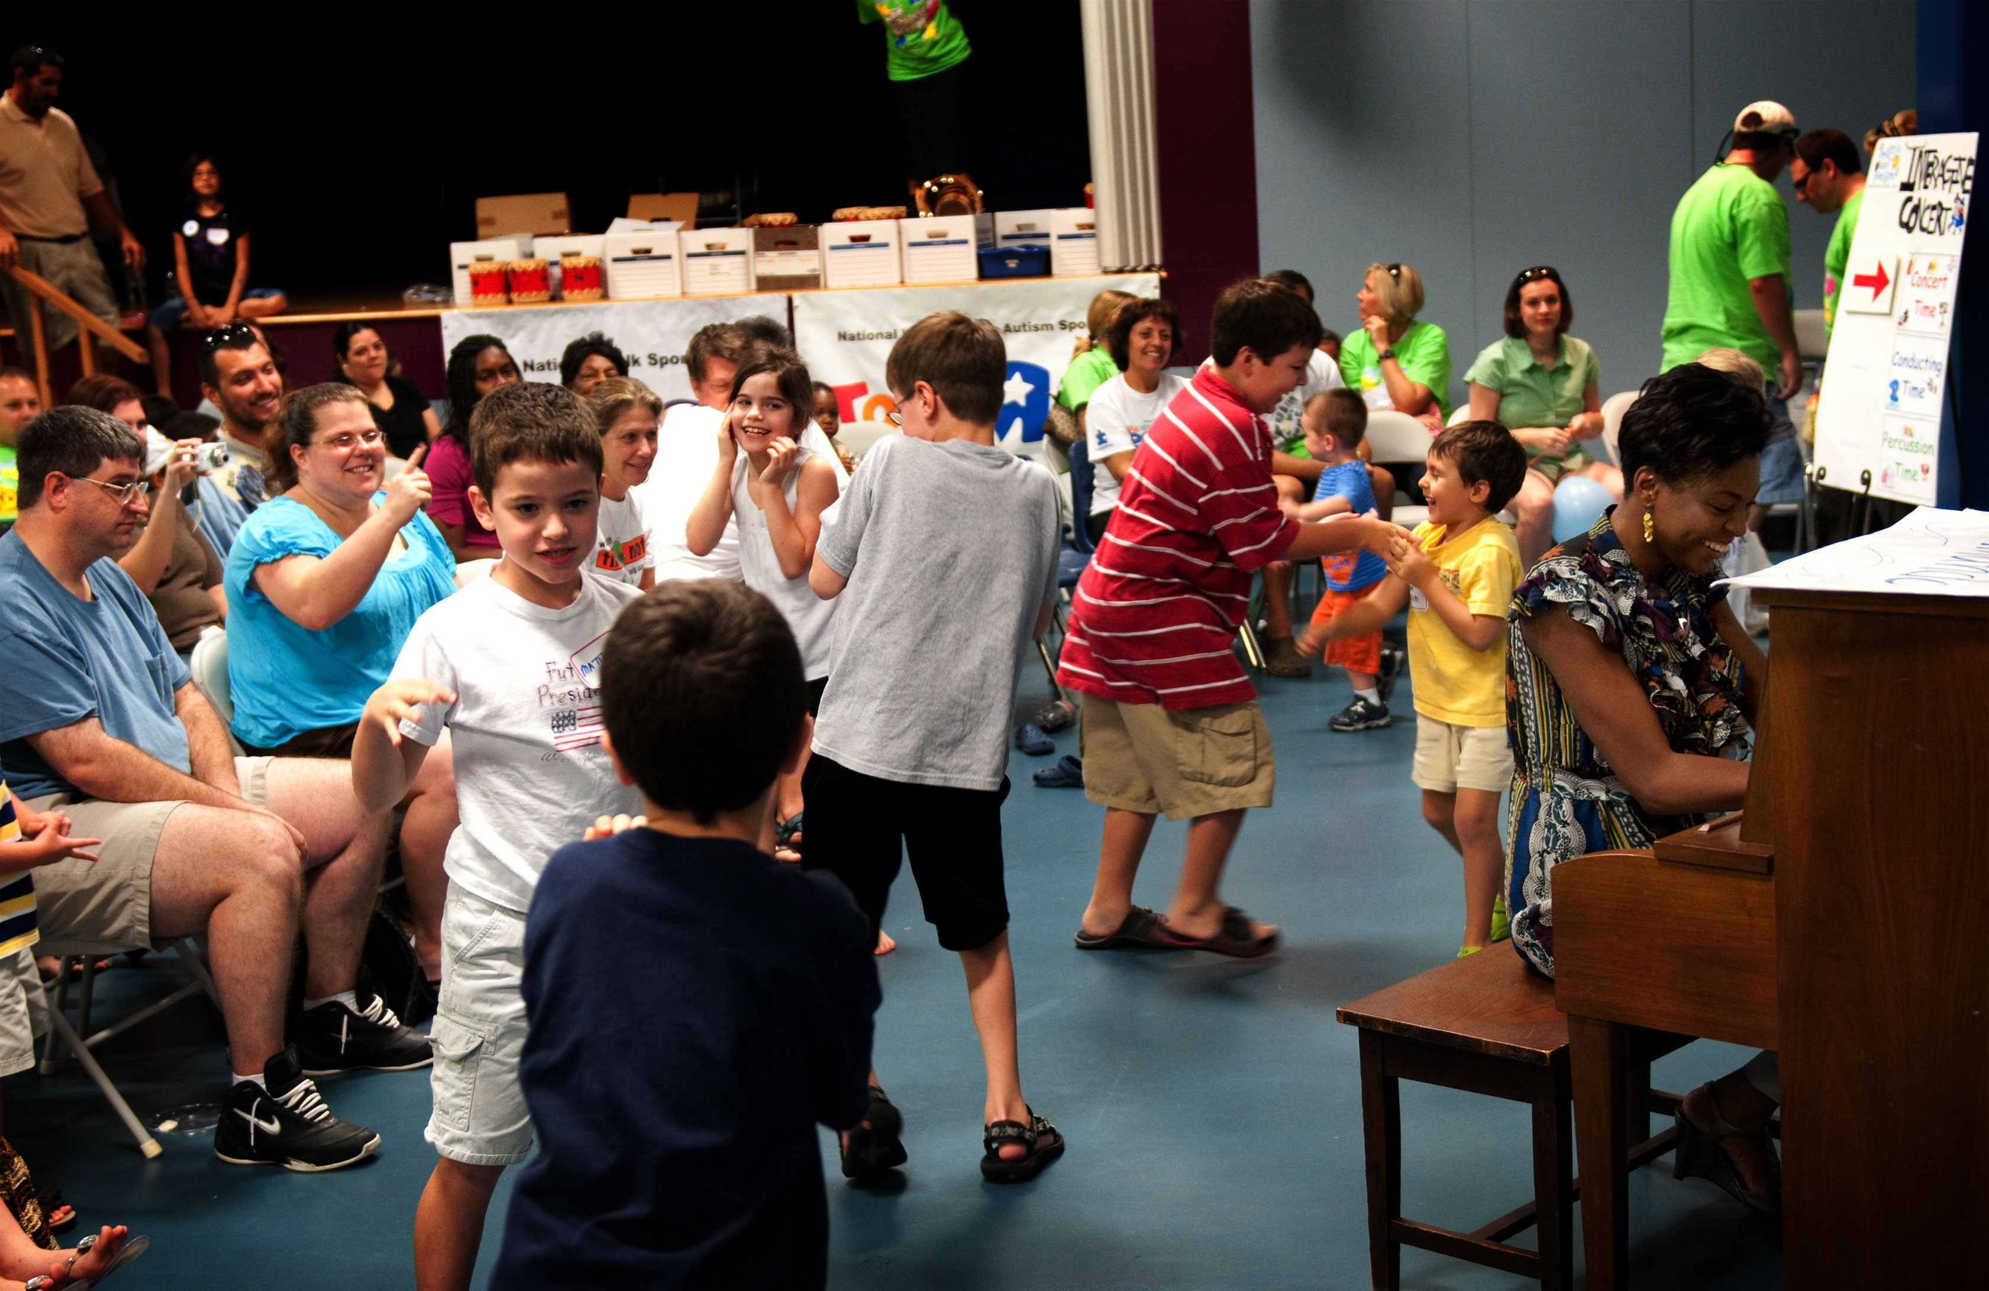
Our Mission
Music for Autism is enhancing quality of life and raising public awareness through free, autism-friendly, interactive concerts developed specifically for individuals with autism and their families.

Slide 25
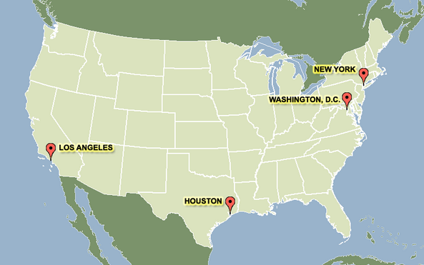

Slide 26
Growth from 2007-2013
In 2007:
1 state
1 city
3 concerts
In 2013:
4 states
10 cities
25 concerts

Slide 27

















Notes:
\

Slide 28

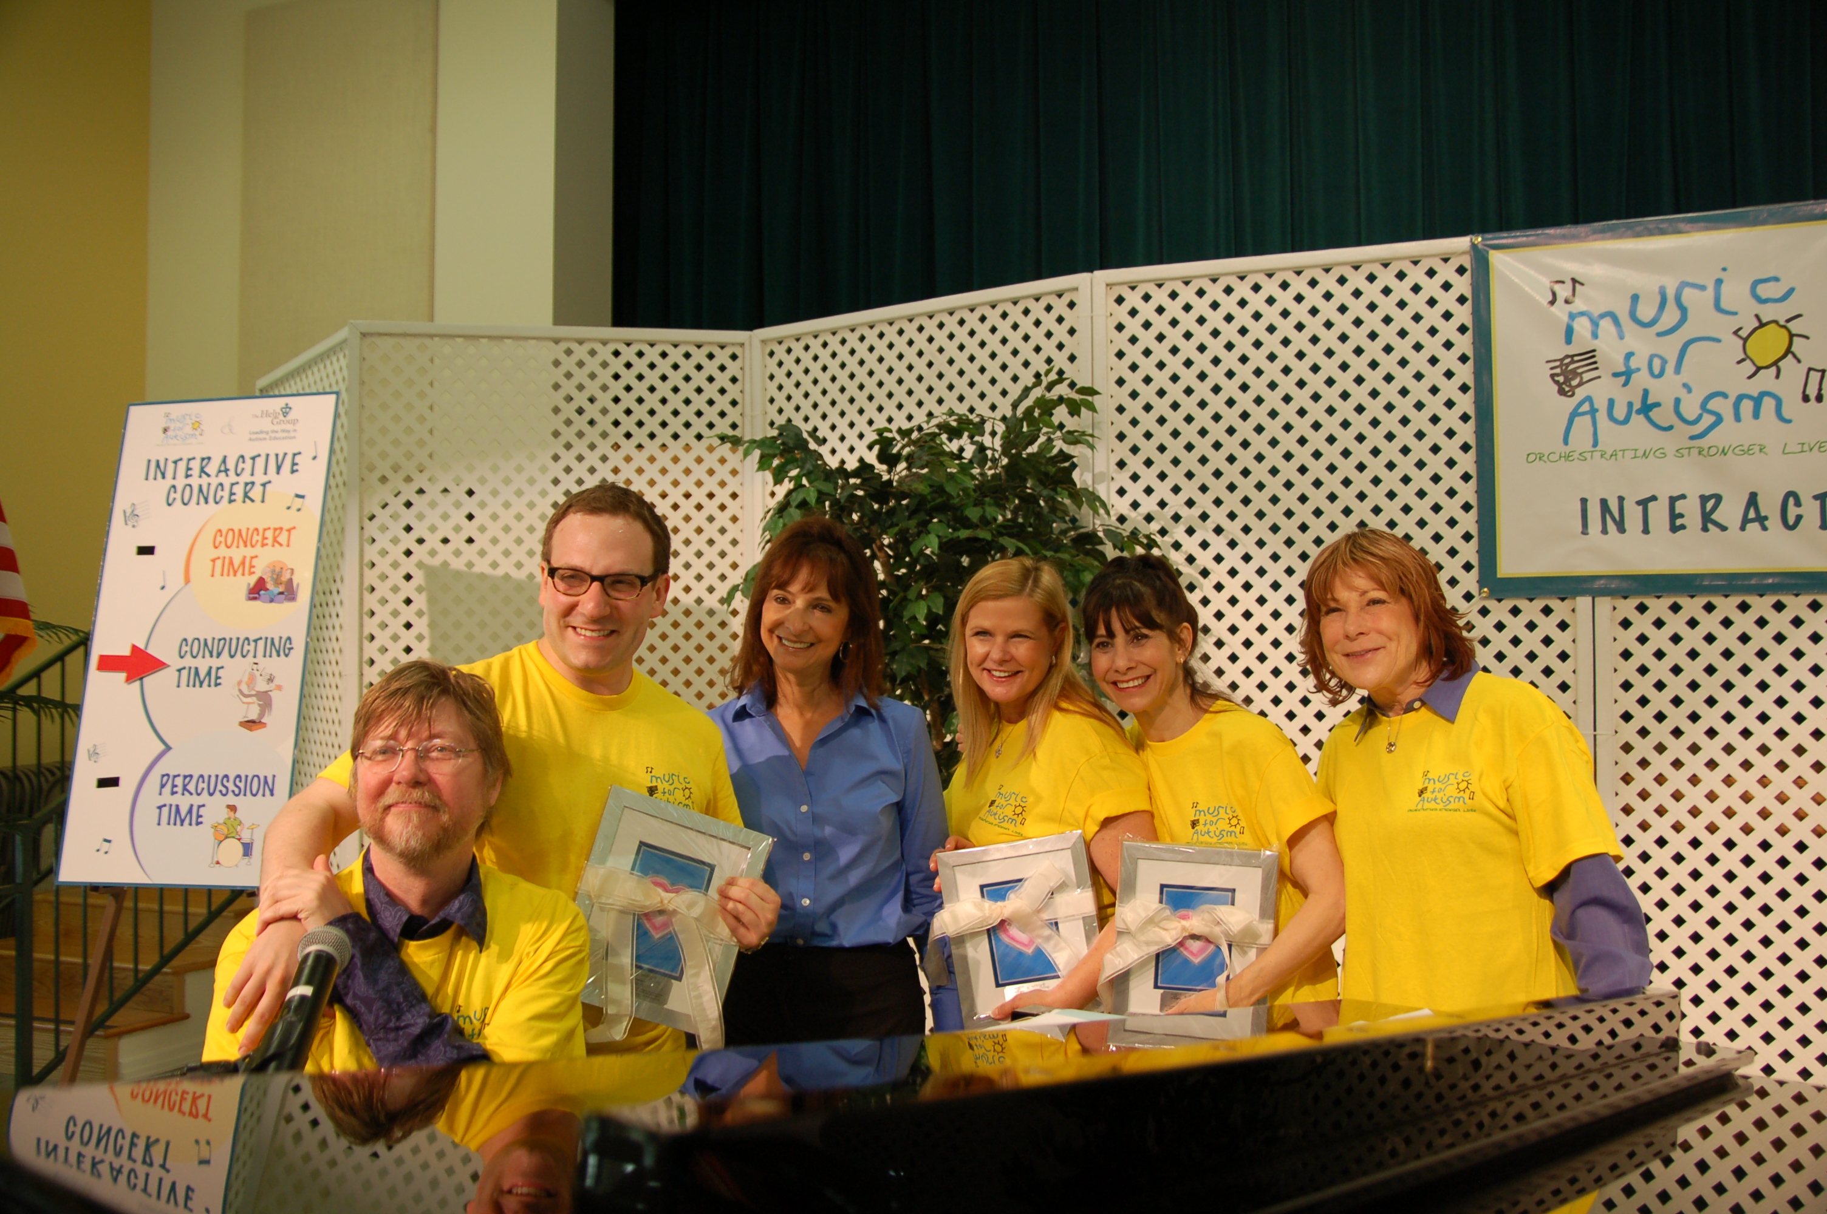
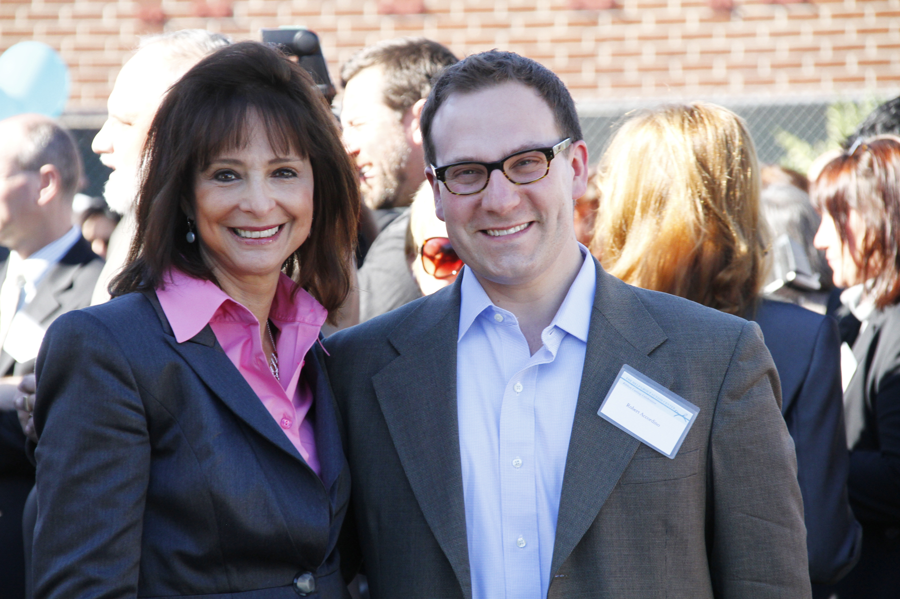

Slide 30

THANK YOU!
Robert E. Accordino, MD, MSc
Robert@MusicForAutism.org
www.MusicForAutism.org
www.HuffingtonPost.com/Robert-Accordino-MD-MSc

